Slide 1

COVID-19 Vaccines Analysis
Name-T.Muzammil
Gmail-tmuzammil55@gmail.com
Collage name-Sri Ranganathar Institute of Engineering and Technology(SRIET)
Course Name-Applied data science

Slide 2
Phase-III
Development
Part 1

Slide 3
In this part you will begin building your project by loading and preprocessing the dataset. Begin conducting the Covid-19 vaccines analysis by collecting and preprocessing the data. Collect and preprocess the Covid-19 vaccine data for analysis.

Slide 4
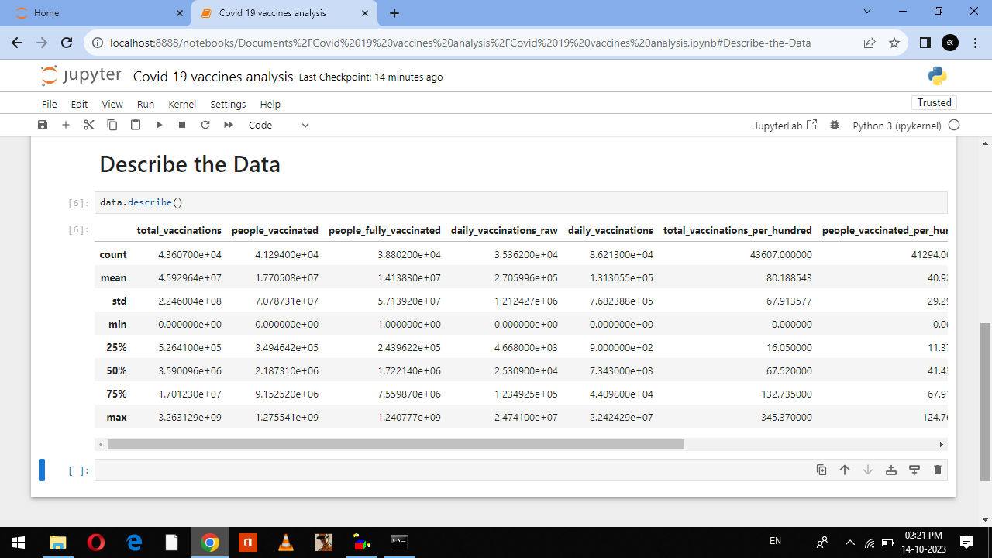

# Describe the Data
Fig.1

Slide 5
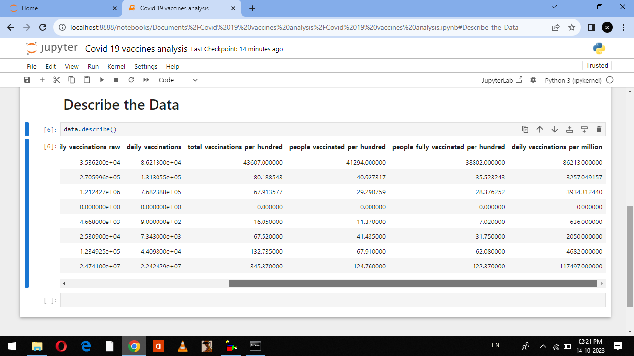

Slide 6
# Data Describe
The Fig.1 is refer the Data describe of Covid -19 vaccines analysis of
Total_vaccinations
People_vaccinated
People_fully_vaccinated
Daily_vaccinations_raw
Vaccines
Source_name
Source_website
Data Describe is information that has been translated into a form that is efficient for movement or processing

Slide 7
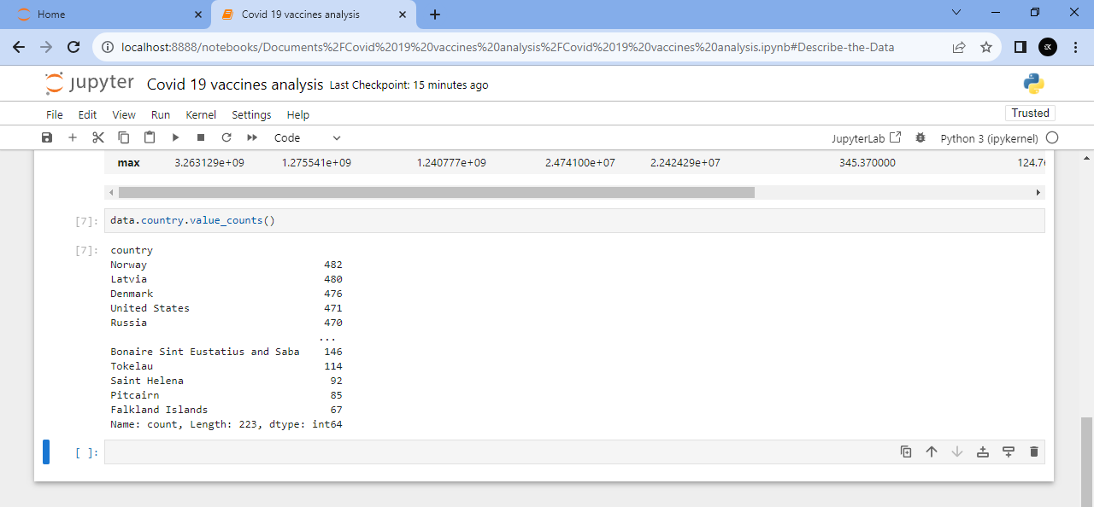
# Data of country and value counts
Fig.2

Slide 8
The Fig.2 is refer to the Data of country and value counts of the Covid-19 vaccines analysis because this fig.2 is have a country of the names and value of the Covid-19 counts are in this fig.2.

Slide 9
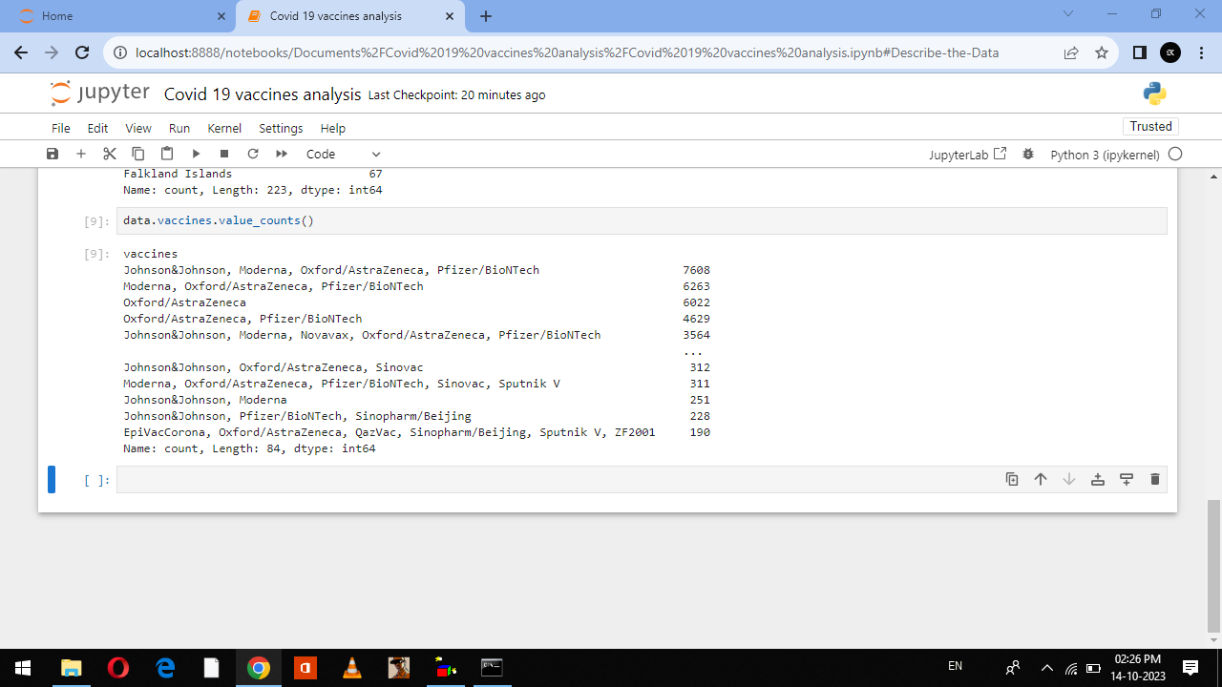
# Data of vaccines and value counts
Fig.3
New cases of the variant in South Africa

Slide 10
The Fig.3 is refer to the data of vaccines and value counts are in Fig.3, thare are vaccines is production by *Johnson&Johnson *Oxford/AstraZeneca *Pfizer/BioNTech *Sinopharm/Beijing and value of vaccines count

Slide 11
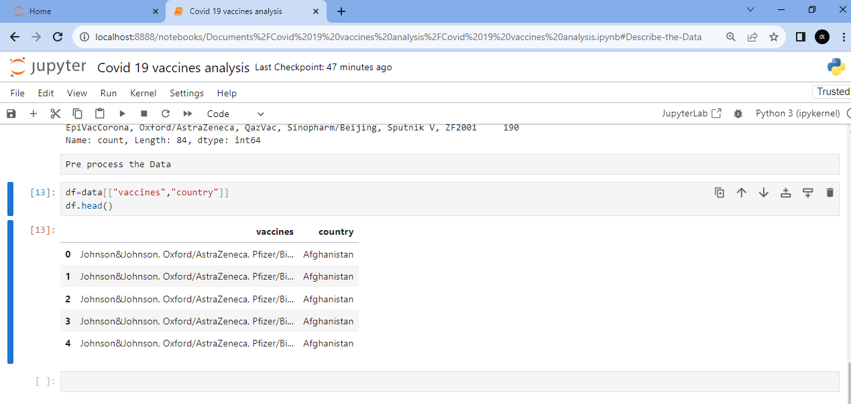
# Data of vaccines used in country
Fig.4

Slide 12
The Fig.4 is refer to the Data of vaccines used in country in the Fig.4 *Johnson&Johnson *Oxford/AstraZeneca *Pfizer/BioNTech *Sinopharm/Beijing this vaccines are used in the country.

Slide 13
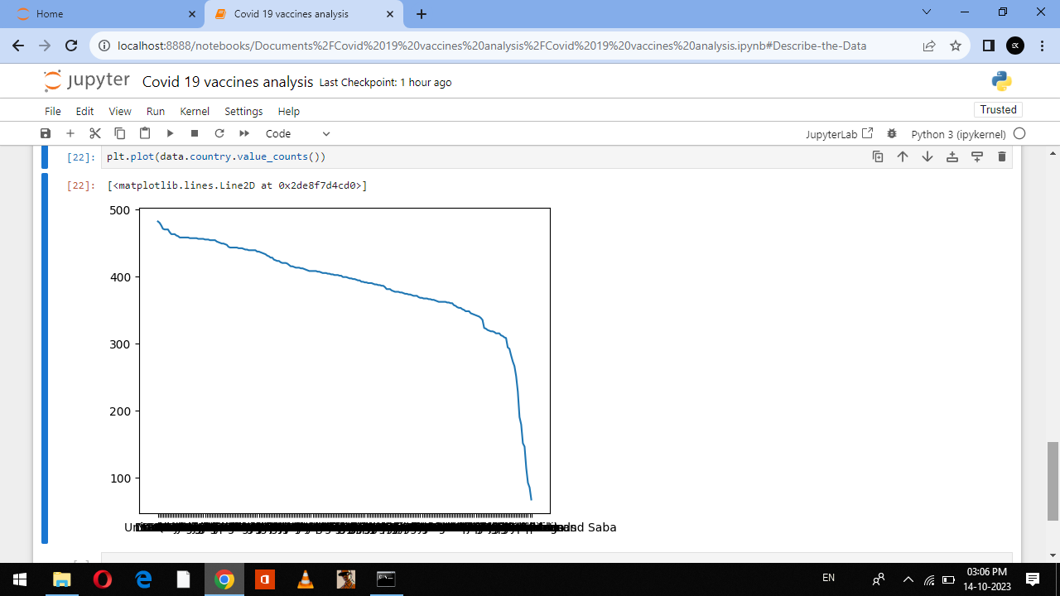
# Line plot graph for Country and value counts
Fig.5

Slide 14
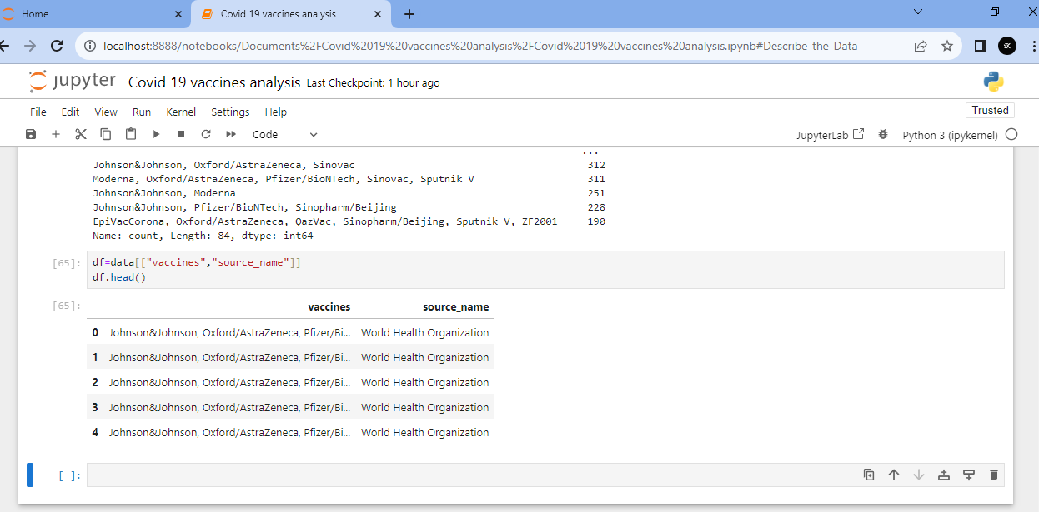
# Data of vaccines and source name
Fig.6.

Slide 15
The Fig.6 is refer to the vaccines and source name in the Fig.6 The source name is World Health Organization of (WHO) is the Source name of vaccines is distributions in all country.

Slide 16
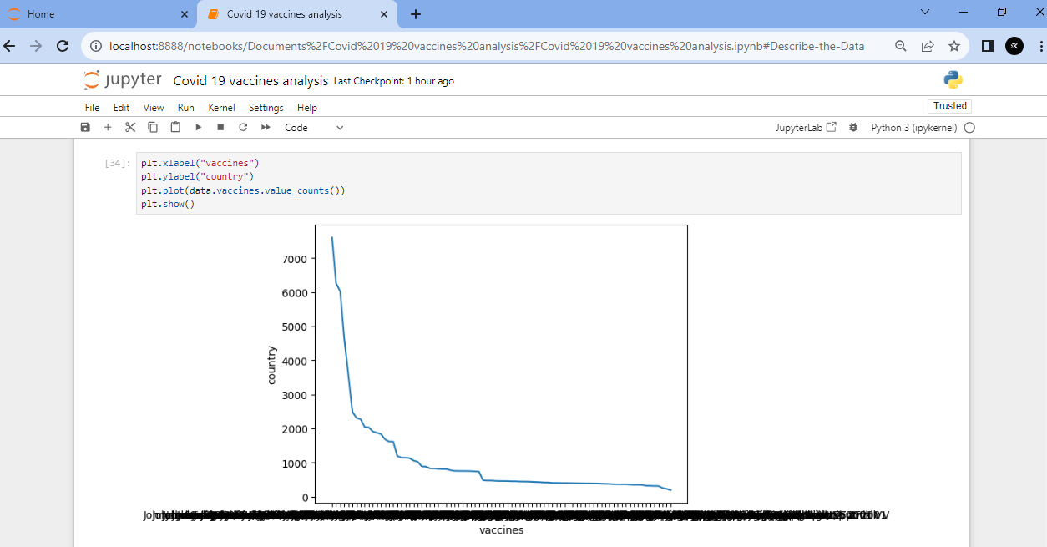
Fig.7
# Data of vaccines and value counts

Slide 17
The Fig.7 is refer to the vaccines and value of vaccines counts in the Fig.7 so there are line plot graph for the vaccines and value of vaccines counts in this graph.

Slide 18
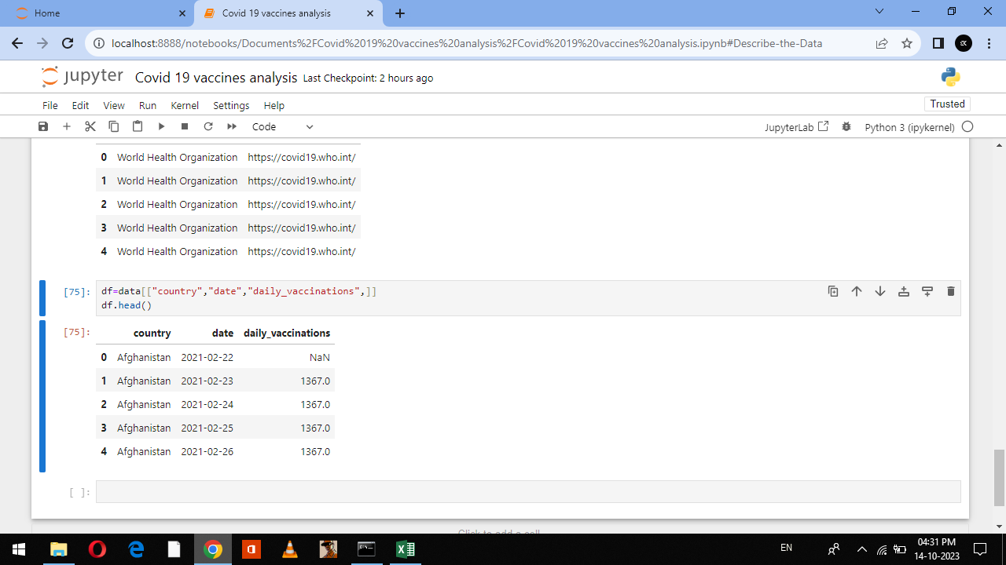
# Data of country and date with daily vaccination
Fig.8

Slide 19
The Fig.8 is refer to the country and date with daily vaccination in Fig.8. there are country name and date with the daily vaccination in Fig.8

Slide 20
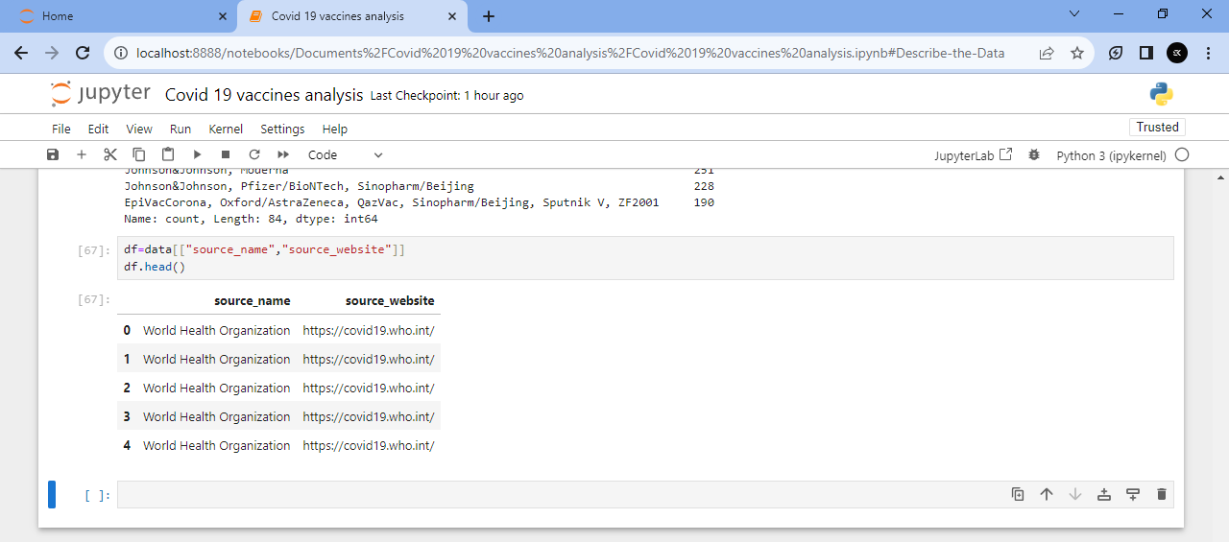
# Data of Source name and source website
Fig.9

Slide 21
The Fig.9 is refer to the Data of source name and source websites in Fig.9 The source name World Health Organization The source websites https://covid19.who.int/

Slide 22
The Data is Collected and pre-processed the Covid-19 vaccine data is analyzed. Then matplotlib to line plot graph used to analyzed the Covid-19 vaccines analysis

